Slide 1
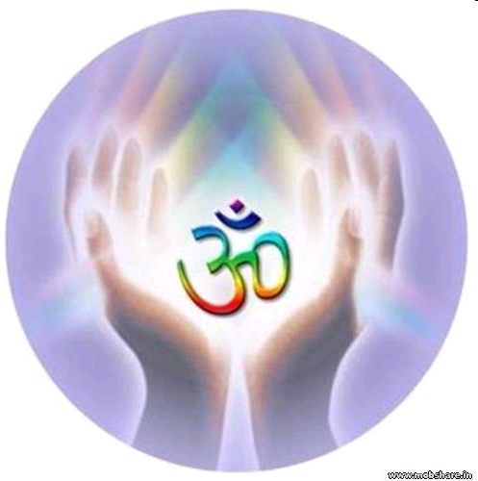
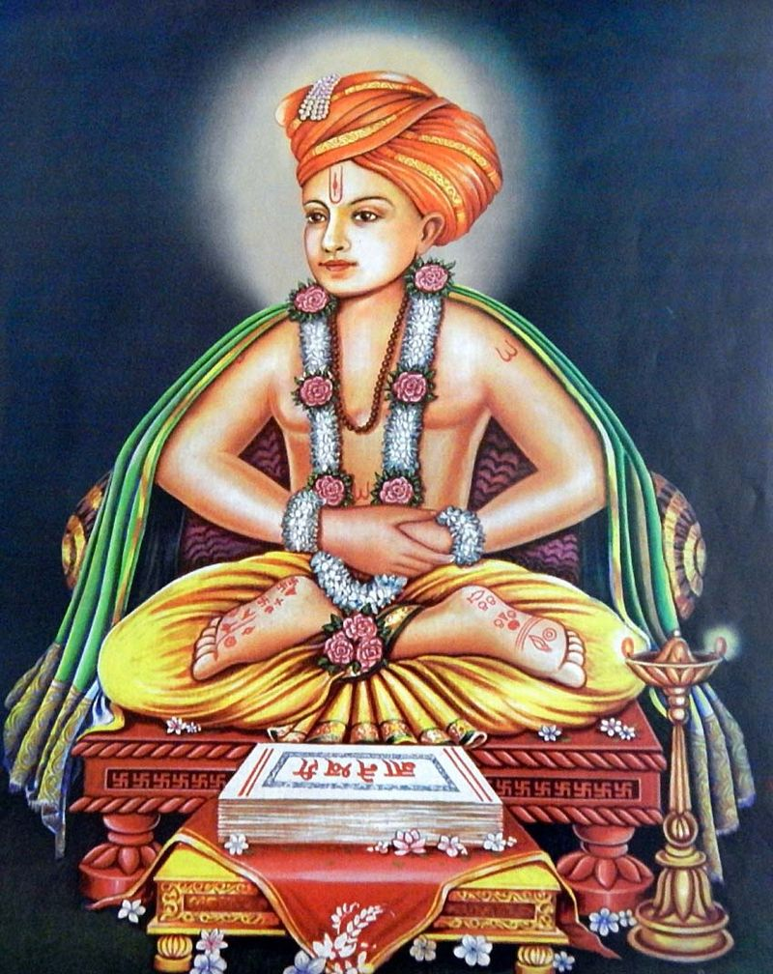

Dr.T.V.Rao MD

Slide 2
Introduction
Brief history of Hinduism
Brief history of Sanskrit language
Ashramas – four stages of life
Four varnas in Hinduism
Family of Sant Dnyaneshwar
Calamities and sufferings
Dnyaneshwari and other works
Miracles
Samadhi
Varakari sect
The movie referred in this presentation: https://www.youtube.com/watch?v=Le5wTROS4oY&t=4646s
Other movie with English subtitles:
https://www.youtube.com/watch?v=J2736UvG4-M&t=1452s

Slide 3
Hinduism
The origin of Hinduism dates back to 5,000 or more years.
The word "Hindu" is derived from the name of River Indus/Sindhu.
The Persians migrated to India called the river "Hindu" the land "Hindustan" (Sanskrit, Hindi), and its inhabitants "Hindus".
Hinduism refers to daily life practices evolved as the religion followed by the Hindus.

Slide 4
Supreme court defines Hinduism
In 1995 The Supreme Court of India highlighted Bal Gangadhar Tilak's formulation of Hinduism's defining features:
Acceptance of the Vedas with reverence;
Recognition of the fact that the means or ways to salvation are diverse; and
The realization of the truth that the number of gods to be worshipped is large.

Slide 5
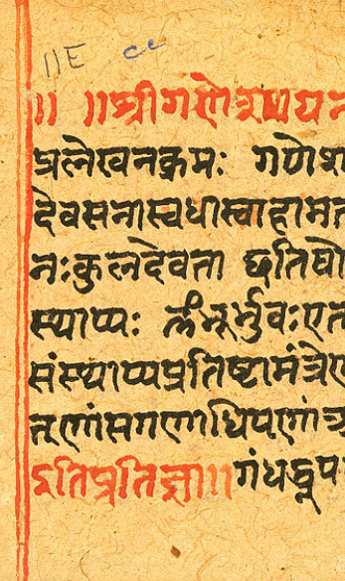
Sanskrit language
Sanskrit संस्कृतम् is a language of ancient India with a 3,500-year history.
Traceable to the 2nd millennium BCE (years 2000 to 1000 BCE - late bronze age).
Vedas are earliest known composition.
Sanskrit compositions were orally transmitted by methods of memorisation.
Has influenced many Indo-Aryan, Munda and Dravidian languages.

Slide 6
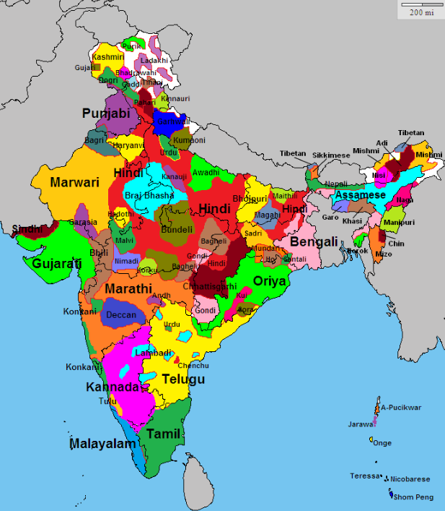
Indo Aryan, Dravidian and Munda Languages

Slide 7
Remarkable literature works in Sanskrit
Vedas – collection of hymns, poems, prayers and formulas written between 1500 and 1000 BCE.
Upanishada contain some of the central philosophical concepts and ideas of Hinduism.
Ramayana – major Sanskrit epic depicting story of Rama and Ravana.
Mahabharata - major Sanskrit epic depicting story of Pandavas and Kauravas.
Bhagvadgeeta - Bhagavad Gita is a synthesis of Hindu ideas on jnana, bhakti, karma and Raja Yoga.

Slide 8
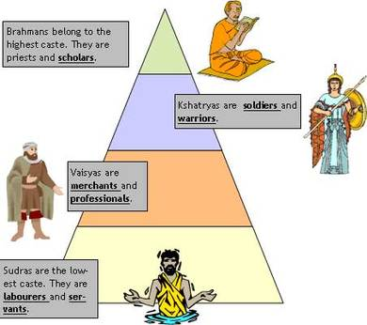
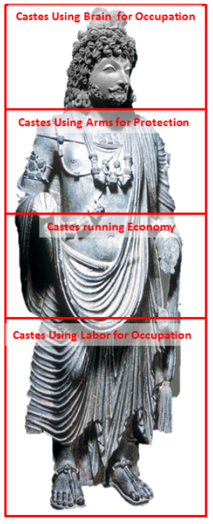
Four Varnas of Hindu Religion

Slide 9
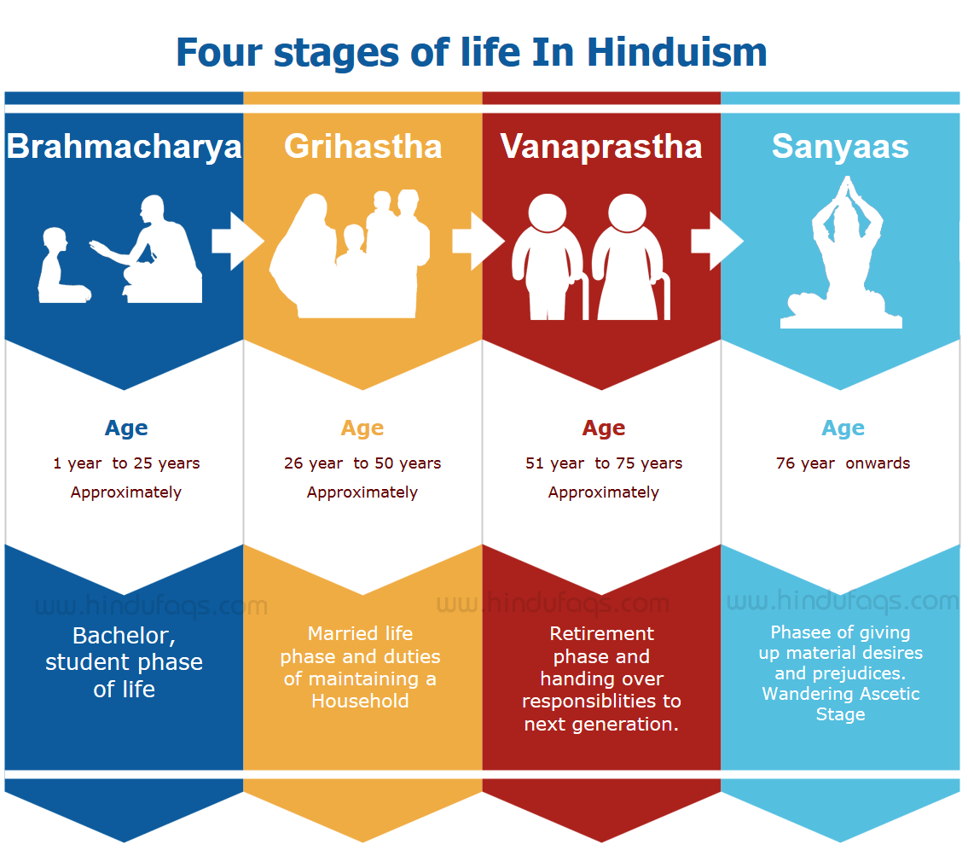

Slide 10
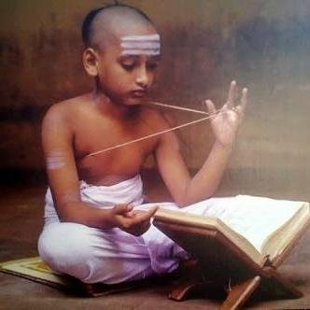
Upanayana Sanskara – The thread ceremony
Sanskara – sacred ceremonies are rites of passage in a human being’s life.
Some examples are: Namakaran, Karnabheda, Vivaha.
Upanayana samskara is done in upper varnas which initiates the child’s formal education.
In this ceremony, Guru accepts and draws a child towards knowledge symbolizing second birth.
A boy receives a sacred thread called Yajñopaveetam, that he wears.

Slide 11
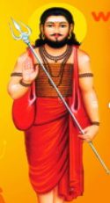
Ancestors of Dnyaneshwar
Ancestor’s place: Apegaon – a village near Paithan in Maharashtra.
Family name: Kulkarni, business: Vatandar (landholder).
Trimbakpant was the great-grand-father of Dnyaneshwar.
First person in the family to have a philosophical and religious bent of mind.
He was a disciple of Great Yogi Guru Gorakhnath.
Govindpant is grand-father of Dnyaneshwar.

Slide 12
Vithalpant – Father of Dnyaneshwar
The thread ceremony took place at the age of 7.
Completed study of Vedas and started on a pilgrimage.
Came to a place called Alandi (near Pune).
Shri Sidhopant gave his daughter Rukminibai to Vithalpant for marriage.
Vithalpant went to Apegaon along with his wife.
But he remained aloof from household duties due to religious and philosophical nature.
Again they went back to Alandi.

Slide 13
Vithalpant becomes a Sanyasi
Vithalpant had astrong desire to become a sanyasi.
He run away from his wife to Kashi (Benaras) and found a guru – Shri Ramanandaswami.
He lied to his guru that he was alone and had no bondage.
After 12 years, his guru came to Alandi.
He blessed Rukminibai that she will conceive a son.
Rukminibai tells him all the story.
Ramanandaswami ordered Vithalpant to begin his family life (grihasthashram) again. (00:20 – 04:10)
See movie https://www.youtube.com/watch?v=Le5wTROS4oY&t=4646s

Slide 14
Birth of Dnyaneshwar and his siblings
Nivritti (1273 A.D.) meaning one gets out of this worldly life
Dnyana (1275 A.D.) meaning Knowledge
Sopan (1277 A.D.) meaning bridge
Muktabai (1279 A.D.) meaning liberation
When Nivritti became due for thread ceremony (10 yo), the brahmins refused as a sanyasi can not have family life.
Vithalpant sought penance for his great sin.
The brahmins declared that the penance is Death. (22:45 – 25:00)
Both, Vithalpant and Rukminibai jumped in the waters of Ganges. (33:40 - 34:30)
Still, brahmins refused thread ceremony of Nivritti.
See movie https://www.youtube.com/watch?v=Le5wTROS4oY&t=4646s

Slide 15
Calamities and studies
They kept on studying vedas and shastra on their own.
Hardship of Dnyaneshwara and his siblings for getting alms. (46:08 – 48:50)
Learnt and mastered the philosophy and techniques of Kundalini yoga.
One day, Muktabai could not get fire for preparing rotis.
Dnyaneshwar kindled the fire inside his body to prepare rotis. (52:45 – 54:20)

Slide 16
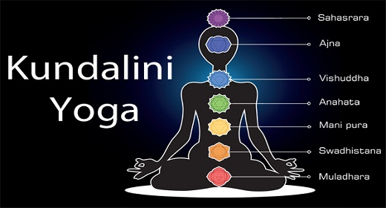

Slide 17
Visit to Paithan
Came to Paithan for getting certificate of purity.
Brahmins of Paithan also did not treat them well.
Dnyaneshwar performed the miracle in which the passing bull recites vedas. (1:13:00 – 1:15:15)
They get certificate of purity, but thread ceremony was never done by Brahmanas in Alandi!!

Slide 18
Dnyaneshwari and other works
The original teachings of Gita were confined to only few brahmins who exploited the society.
Vithalpant inspired Dnyaneshwar to preach knowledge of Gita to common people.
Dnyaneshwar wrote the first literature work in Marathi called Bhavartha Deepika (aka Dnyaneshwari) to explain teaching of Gita in Prakrit Marathi language.
It is composed in a meter called ovi and has 18 chapters.
He wrote another book Amrutanubhav explaining non-dualism.
Also wrote many other smaller compositions like Changadev Pasashti, Haripath etc.

Slide 19
Some excerpts from Dnyaneshwari
Made available online by Dr. V. V. Shirvaikar (http://www.vvshirvaikar.de/Dnyaneshwari/index-dn.html)
Dnyaneshwar Maharaj says," There is no doubt that Knowledge leads to liberation. But in order that the knowledge steadies itself in a person the mind must be very pure. Without detachment knowledge cannot be steady. This principle has been very thoughtfully stated by Shri Krishna who has also discussed how the mind can get completely detached. Just as, a person taking his meal leaves the dish and runs away if he knows that there is poison in it, similarly once the idea of the impermanence of this world gets stamped on the mind one runs away from attachment and the detachment (thus attained) does not leave you even if you try to get rid of it. In this fifteenth chapter Shri Krishna is explaining how the world is impermanent using the simile of a tree." (15:35-40).

Slide 20
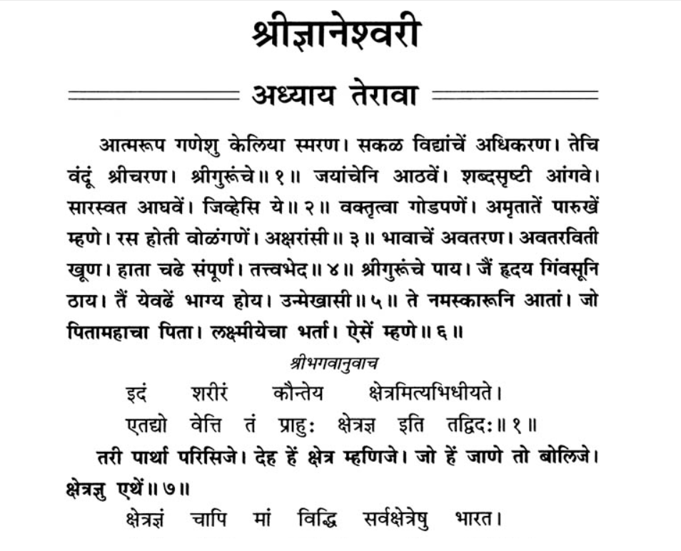

Slide 21
Other noted miracles
Dnyaneshwar touches a lifeless body of Satchitananda to bring him to life. (1:33:45 – 1:36:30)
Visit of 1400 yr old Yogi Changdeo riding a tiger and Dnyaneshwar rides the wall (2:09:01 – 2:14:10)

Slide 22
Samadhi
After composing Amritanubhava, Dnyashwar went on a pilgrimage along with Namdeo and other saints.
After the visit, Dnyaneshwar felt that the mission of his life was over and expressed his intention to take Samadhi.
He entered into Sanjeevan Samadhi at Alandi at the age of 21 (1296 A.D.) (2:24:30 – 2:26:45)
His siblings also took Samadhi within a year’s time.

Slide 23
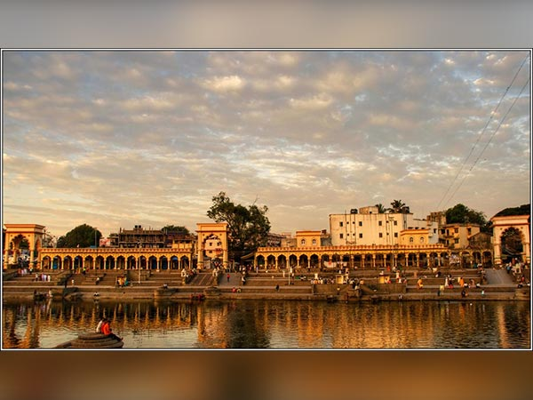
Samadhi Temple in Alandi

Slide 24
Varakari Sampradaya
Varakari (pilgrim) is a samoradaya (religious movement) in Hinduism based on the teachings of Dnyaneshwar and other contemporary saints.
They look upon God as ultimate truth and accept ultimate equality among people.
Everybody is brahma and stress on simplicity, compassion, non-violence, love and humanity.
Two annual pilgrimages to a place called Pandharpur.

Slide 25
Some References
Saint Dnyashwar https://web.iiit.ac.in/~sarvesh.ranadeug08/project/saints/Saint%20Dnyaneshwar.html
Sant Dnyaneshwar http://www.hindupedia.com/en/Sant_Dnyaneshwar
Dnyaneshwar https://en.wikipedia.org/wiki/Dnyaneshwar
Dnyaneshwari http://www.vvshirvaikar.de/Dnyaneshwari/Dnch6pg1.html
Varakari https://en.wikipedia.org/wiki/Varkari

